Slide 1
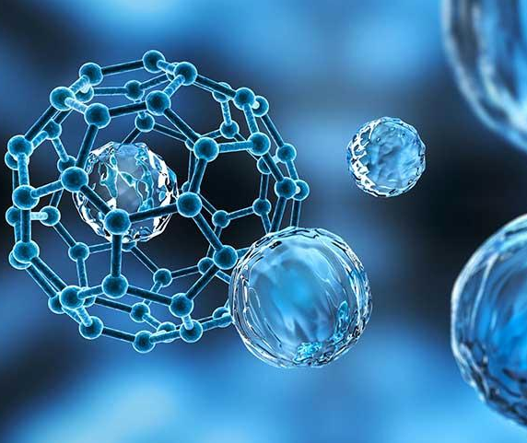
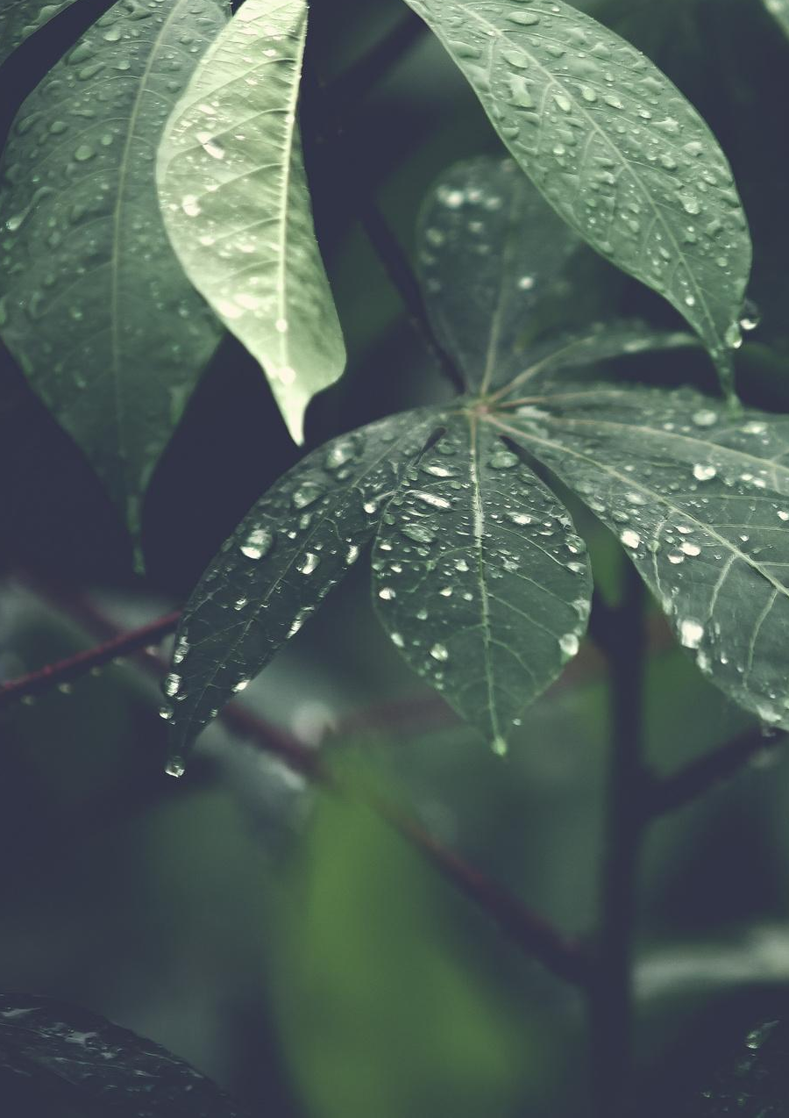

TORSKAL
NANOSCIENCE
Pioneer in green nanotechnology
Anne-Laure Morel, CEO

Slide 2



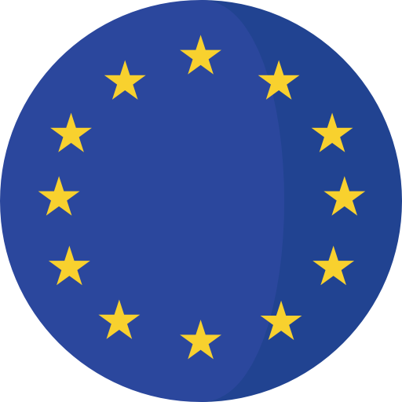
The world has a skin cancer issue…
5 to 13
4’
1/3
of all malignancies diagnosed worldwide yearly
Every 4’ a person dies of skin cancer
millions cases/year worldwide estimated*
2
Keratinocytes (or Non-melanoma skin cancer)
Melanocytes (or Melanoma skin cancer) (aggressive ++)
90%
of skin cancer are Keratinocytes
Main Types
1/5
$8.1 bn
USA, Australia & Europe have the highest incidence rates
American will develop a skin cancer in their lifetime
average annual cost of skin cancer treatments in the USA
*Sources : WHO, cancer.org, skincancer.org, journal of the American Academy of Dermatology, bmccancer.biomedcentral.com, British Journal of Dermatology,

Slide 3
…and existing treatments are either highly invasive or toxic
Torskal main research program focus on Keratinocytes (Non melanoma skin cancer) for which existing treatments are still presenting multiple undesirable effects while Torskal’s promises none of them.
Main Treatments for KC
Undesirable Effects
Scars
Burst
Pain
Toxicity
Reoccurrence
Priority
Treatments
1st line
Excision or Mohs Surgery
2nd line
Cryotherapy
2nd line
Hedgehog inhibitors
2nd line
PDT + Topical Cream
3rd line
Radiotherapy
NEW!
Torskal’s Gold Nanoparticles (NT1)
Torksal’s innovation has the potential to come as 1st line treatment
Key
No risk
Medium risk
Certain risk

Slide 4
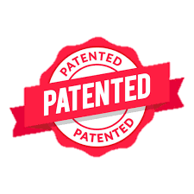


Torskal innovates with a non-invasive and non-toxic treatment with high efficacy using green nanotechnology
After a 7 years R&D, Torskal developed a bio-treatment (NT1) made of gold nanoparticles and medicinal plants combined with non-ionizing laser to cure skin cancers. The treatment destroys physically the tumor by heat without affecting healthy tissues and without leading to inaesthetic scars.
High level description of the process
Non-ionizing radiation
Plasmonic Photothermal Therapy (PTT)
Spherical 15nm ∅
Gold Nanoparticle
+
=
Complete thermal destruction of the tumor
This first bio-treatment (named NT1) is classified as Class 3 Medical Device and showed excellent results during preclinical phase on mice. We are now fundraising 15m€ to launch clinical phase, get approval from regulatory authorities and bring the product to market.
Other research program, NT2 & NT3, leverage the same green and therapeutic approach on deep organ cancers. Three drug candidates (pancreas, prostate and lung) will be ready for preclinical studies in 2023

Slide 5
Torskal’s mission is to enable a curative therapy for skin cancer applicable to other areas

Slide 6
Two main types of skin cancer
KERATINOCYTES
Torskal’s priority target
MELANOCYTES
Torskal’s secondary target
Roughly 90% of skin cancers
Most common form of cancer in humans
Can be highly destructive and disfigure local tissues
Roughly 10% of skin cancers
20-30% of melanomas are found in existing moles
70-80% occur in normal-looking skin
Begins in the top layer of the skin, grows slowly and rarely spreads
A range of treatment options are available of which
surgery is the gold standard
The melanoma is a serious form of skin cancer and is the most dangerous because of its ability to spread faster to other organs if not detected and treated early
Roughly 80% of keratinocytes are Basal Cell Carcinoma
Globally, higher incidence in males (60.3%)
324,635 new cases worldwide in 2020 and 57 043 deaths
Globally, higher incidence in males (62%)
2 types of Keratinocytes Basal cell carcinoma (BCC) and Squamous cell carcinoma (SCC)
The incidence is increasing by 4% to 8% annually, which is heavily influenced by cumulative sun exposure and an aging population
7th cancer in number of incidence
18th in term of mortalityn
The melanoma skin cancer is estimated to increase to 510 000 new cases and to 96 000 deaths by 2040

Slide 7



… and the burden continues to grow with population ageing, growth worldwide and climate change
Forecast of world population growth
(in billions)
According to the United Nations, the world's population is expected to reach 8.5 billion by 2030, rising to 9.7 billion by 2050 and 10.4 billion by 2100.
Between 2020 and 2050, the proportion of people aged 60 and over in the world's population will almost double, from 12% to 22%, and is expected to reach more than 2 billion people.
Global warming is expected to favor skin cancers; it is estimated that the aging population and global warming will result in a doubling of the number of cases within 10 years.
Sources : United Nations - https://population.un.org/

Slide 8
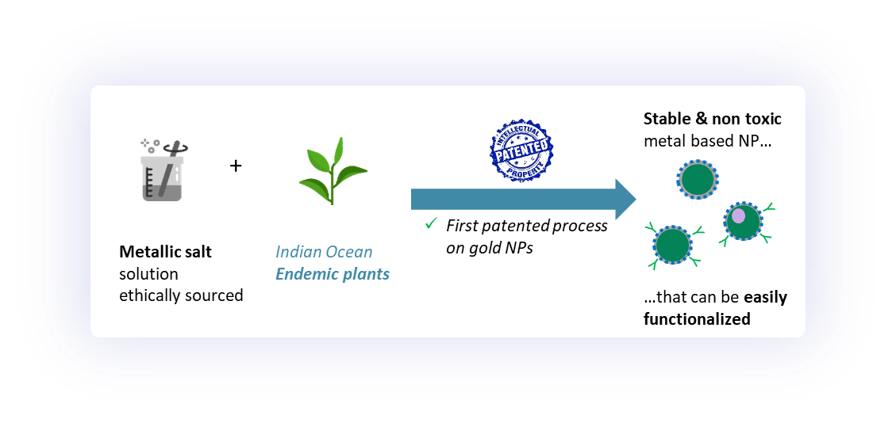
Torskal developed a new noninvasive and nontoxic treatment for Keratinocyte based on nanomedicine with medicinal plants extracts
What is Nanomedicine and Nanotheranostics?
Nanomedicine uses nanotechnologies to develop innovative applications, thanks to the exploitation of the physical, chemical and biological properties of materials at the nanometric scale (called nano objects).
Size reduction of various structures below the micrometer highlighted new properties not observed at conventional sizes.
Nanotheranostics is an advanced field of medicine that uses nanoparticles to simultaneously diagnose and treat diseases.
Nanoparticles serve as molecular "cargo" carriers.
Torskal scientific team has discovered an innovative and green way of producing gold nanoparticles (patented), leveraging Indian Ocean endemic plants having numerous applications in health
It focuses today on oncology, but the technology can be applied to other therapeutic areas in later phases
Torskal developed NT1, its first lead nanotheranostic. Ready to be tested on humans after promising POC efficacy results in Carcinoma Basal Cell and Melanoma.
“ Green nanotheranostics
to better diagnose, monitor
and cure differently
high unmet needs cancers,
leveraging physical properties
of non-toxic Nanoparticles ”

Slide 9

Supply of medicinal plant in a European region with an incitative policy for investment
1Ha of agricultural exploitation supplies 1 ton of fresh plants, for the production of 56,000L of NPs/year
Global scale : total patient need is 2,000L NP/year
For 10% of market share, 1Ha area can provide 200L NP/year
On one hectare o
Fresh Plants
1000 kg
Drying
Dried and ground plants
300 kg
Extraction with innovative method
Extraction with classic method
ASE350 : Accelerated Solvent Extractor
Yield = 30%
T = 80°C
Duration = 1hour
Yield = 47%
Dry extract per year
90 kg
Synthesis of Gold nanoparticles
Dry extract per year
141 kg
Liquid extract
5g/L
60,000L of liquid extract
For 1L of GNPs, 2,5g of dry extract is required
Dilution DF = 2,5133
C = 0,935 g/L
C = 0,935 g/L
HauCl4
HauCl4
Liquid extract
0,935g/L
TORSKAL 001
36,000 L per year
TORSKAL 001
56,400 L per year
Synthesis of Gold nanoparticles
1L of liquid extract (0,935 g/L) produce 375mL of TSK001
TORSKAL 001
56,550 L per year

Slide 10






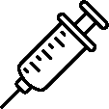

Torskal’s technology: gold nanoparticles combined with laser for a physical destruction
Detailed high-level description of the process :
HAuCl₄
Gold Mine Extract
“Fairmined” (ethically sourced)
Non-ionizing radiation
(via Near Infrared laser - NIR) inducing exalted hyperthermia of AuNP
Spherical 15nm ∅ Gold Nanoparticle
+ glucose coating
+
=
Complete thermal destruction of the tumor
+
Hubertia
Ambavilla
Plasmonic Photothermal Therapy (PTT)
Replacing the chemical compounds
Destroy, in few doses, the tumor, by heat, without affecting healthy tissue and without leading to inaesthetic scars
Intra tumoral
Injection of Gold Nanoparticles
Non-ionizing radiation via
Near Infrared laser inducing hyperthermia of AuNP
Thermal destruction of tumor cells, by
apoptosis exclusively

Slide 11
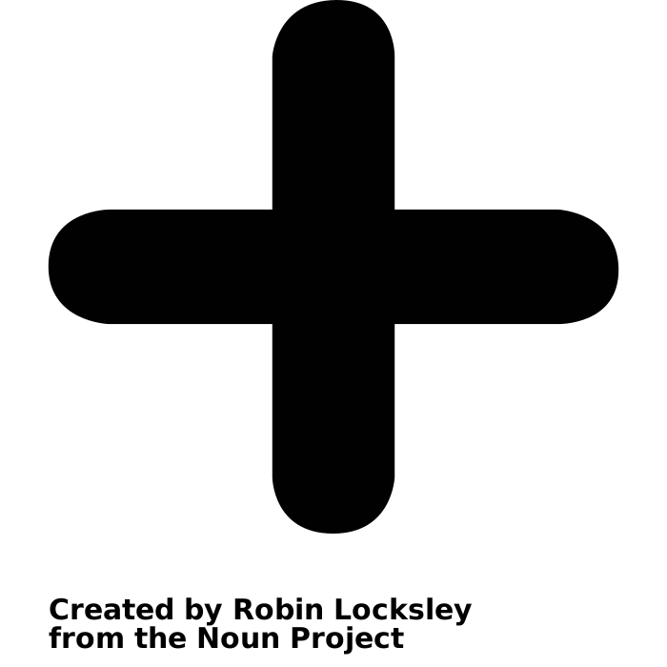

The first patented process on gold nanoparticles
Redox
01
Metallic salt solution ethically sourced
(reducer)
Indian Ocean Endemic Plants
(oxidizer)
Stable & nontoxic metal-based NP that can be easily functionalized
Growth Nucleation
02
Arrangement of gold atoms into nanoparticles
Stabilization
03
Stop NPs’ growth in order to give the desired shape and size.
Functionalization
04
Sugar deposit on the gold surface. Nanoparticles are functionalized by glucose to stabilize them in water or in physiological liquid. The nanoparticles will be captured by tumor cells needing sugar to grow.

Slide 12
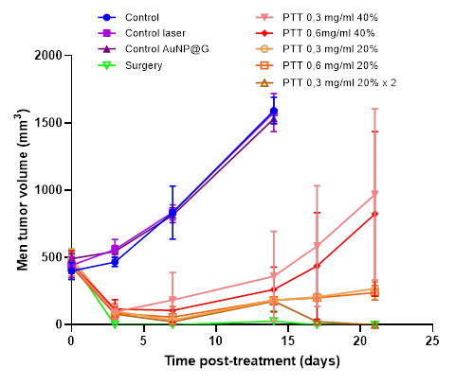
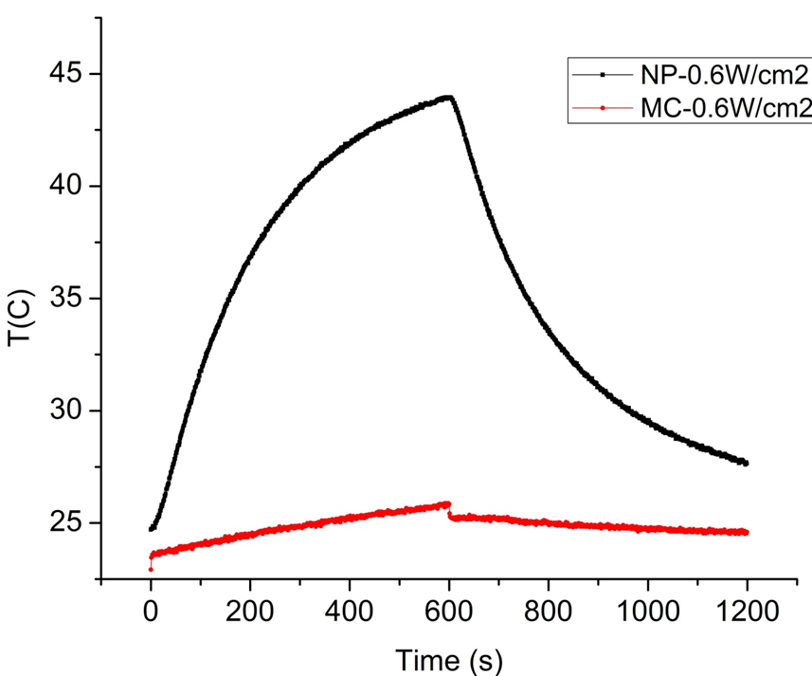
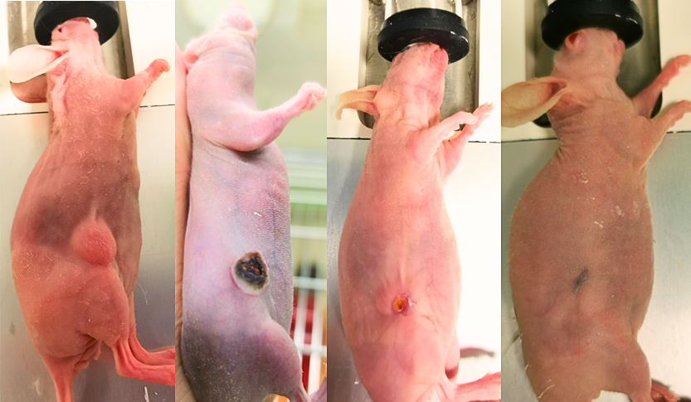
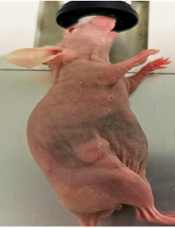
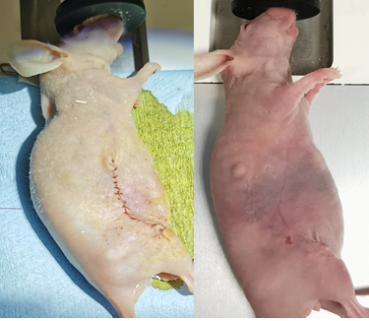
Preclinical POC NT1 : complete destruction of skin cancer after 14 days
Torskal performed preclinical trials during in 2021/22
Key findings:
  No mortality or signs of systemic toxicity were observed (cytotoxicity grade 0 in all cases)
  Biodistribution : remains inside the tumor at least 24 hours and elimination in urine and faeces
  100% complete regression in mice treated at 14 days intervals
Tumor size as a function of time after injections
Hyperthermia induced by NP’s + Laser
--- With NP
--- Without NP
Torskal’s solution
Vs.
Surgery
Power laser: 0.6 W/cm²
Increase of temperature: ~20°C
Mechanism of action: Exalted hyperthermia, inducing apoptosis
2 single injections: Day 0 + Day 14
A 7°C to 10°C delta with body temperature is necessary to enable tumor apoptosis

Slide 13
NT1 Product Profile
NT1 will be developed in priority for skin cancer patients given the reoccurrence rate and the aesthetic needs to replace surgery.
A secondary use of NT1 could be for cutaneous lesions of metastatic melanoma.
Regulatory Statut
Class III medical device
Mode of Action
Plasmonic Photothermal Therapy (PTT) on Gold NPs via Infrared 800-1200nm elevating temperature by 7°C to 44°C
Target population
Priority indication : Bascal-cell carcinoma (BCC) patients, to replace or complement surgery
2nd indication : Cutaneous lesions of metastatic lesions
3rd indication : Melanoma patients in combination with conventional treatments
Formulation
In solution
Administration Scheme & Dose
  Intratumoral injection followed by Near Infrared radiation
  ~ 1mL/tumor, depending on size
  +/- Repeated after 15 day

Slide 14
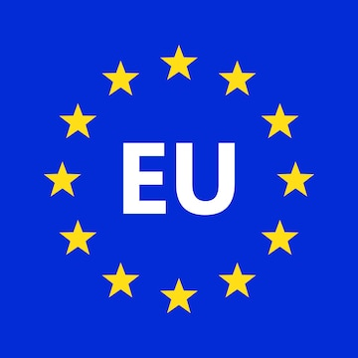
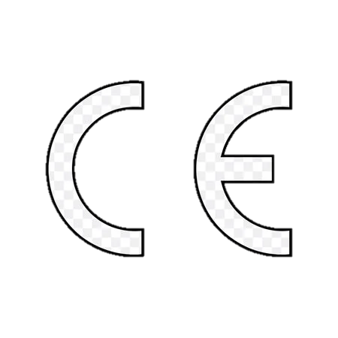


NT1 Development : What’s next ?
Technical Documentation
Phase 2
Launch in Europe
EMA Filling
Phase 2
Launch in USA
Pre-IND
FDA Meeting
FDA Filling
Phase 2
Launch in Australia
TGA Filling
Pre-Ib Meeting Scientific Advice
Technological transfer
IB, CIP, medical writing
Phase 1
Product
Notified Body Meeting
GMP production
Product development
First in Human (1b/2a)
Launch
2021
2022
2023
2024
2025
2026
2027
2028
Regulatory steps

Slide 15
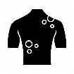



Torskal develops nanotheranostics dedicated to the monitoring and treatment of different cancers leveraging physical properties of non-toxic nanoparticles
NT1
NT2
NT3
Through JV w/ Anatin Biotech
Priority
Low priority
Medical Device (MD) status, class III
Probably Chemical Drug status
Probably MD status, class III
Surface
cancers
PTT
Deep organ
cancers
Deep organ
cancers
PTT
Drug candidates
Drug candidates
Drug candidates
NT1a :
BCC
NT1b :
Melanoma
NT2a :
Pancreas
NT2b :
Lung
NT3a :
Bladder (UBC)
NT3b :
Prostate
Priority indication
Second indication
Priority indication
X Rays
X Rays
Therapeutic strategy
Therapeutic strategy
Y
Y
Therapeutic strategy
Injection of Gold Nanoparticles combined with Near Infrared laser
Injection of NPs functionalized with ligand vector
Y
Y
Injection of Gold NPs combined with Near Infrared laser
Near infrared
Near infrared
For :
TTT of resecable surface cancers (BCC)
TTT of melanoma in combination with immunotherapy
via Plasmonic Photothermal Therapy (PTT)
For :
TTT of deep organ cancers via targeted moities
Tumor progression monitoring with routine medical imaging
For :
TTT of urogenital cancers (bladder cancers)
Tumor progression monitoring with routine medical imaging
2023
2024
2025
2026
2027
2028
Preclinical
NT1
Clinical Development
NT1
Clinical Development
NT3
Launch
NT1
Launch
NT3
Preclinical
NT3

Slide 16
As a dermo-therapy, our treatment promise high efficacy with no side effects nor recurrence
Torskal's innovation provides patients access to an effective, rapid, non-invasive, painless and non-toxic treatment
Treatment type | Surgical resection or Mohs Surgery | Cryosurgery | Hedgehog inhibitors (HPI) | Dynamic Phototherapy (PDT) | Radiotherapy | Torskal NT1
Depth | Deep | Surface | Surface | Surface | Surface | Deep
Reoccurrence probability | Weak | Probable | Weak | Probable | Probable | Weak
Toxicity | No | No | High | High | No | No
Comments | A lot of skin is extracted (including safe tissues). Not applicable to thin skin areas. | Might not destroy all tumoral cells | Destroys also safe tissues, Teratogenic substance | Topic cream, Superficial treatment, not applicable to deep cancers | Not applicable on difficult to reach areas (eyes, head, nose, etc.) not applicable on elderly people. | Target only the tumor and applicable to any area
Sequels/ Side effects | Anesthesia, disfiguring scars | + | Pain, fatigue, nausea, diarrhea, tissue disorders, Pruritis, redness, | Pain, burst | Pain, burst | None
Costs of treatment (estimation) | USA : 2500$ to 12 000$ AUS : 500$ to 700$ EUR : from 1 000€ to 8 000€ | USA : 200$ to 500$ AUS : 150 to 350$ EUR : 1 500€ to 4 500€ | USA : 12 000$ to 15 000$ AUS : N/A EUR : N/A | USA : 300$ to 600$ AUS : 1 000$ EUR : approx. 1 500€ | USA : 2 000 $ to 8 000$ AUS : 400 to 1 000$ EUR : approx. 3 800€ | To be confirmed

Slide 17

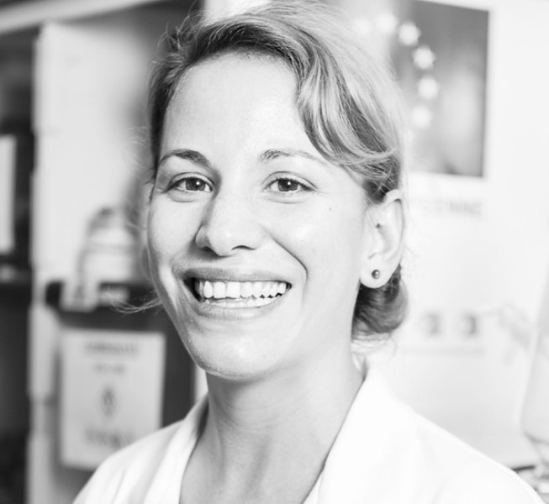
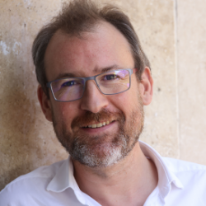
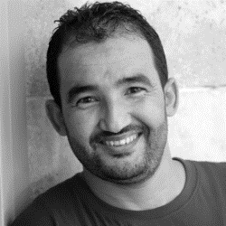

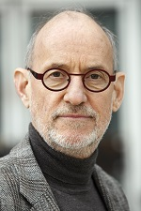
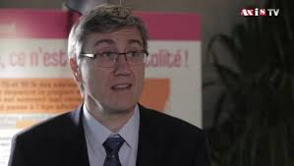
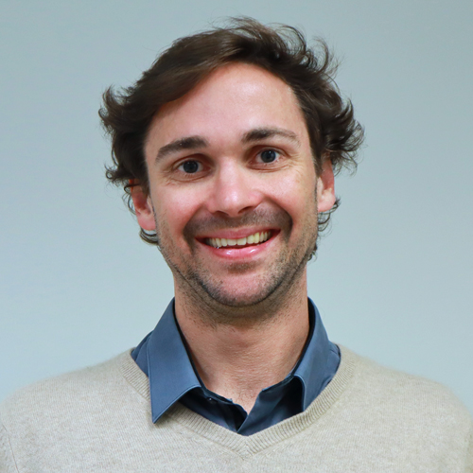
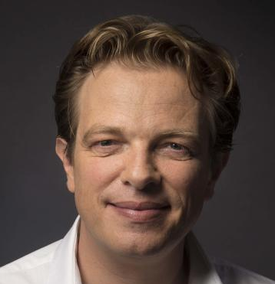
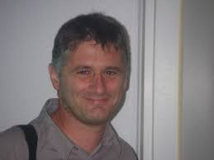
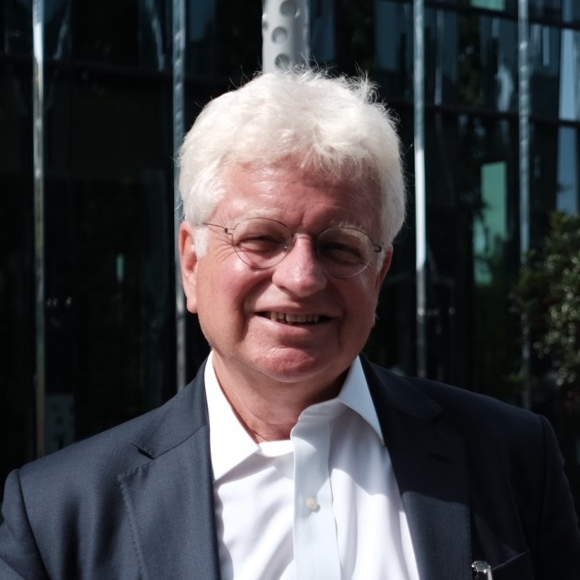

A high-level experts' team …
Anne-Laure MOREL
Chief Executive Officer
Christophe DUGUÉ
Chief Legal Officer
Rachid CHAWECH
Senior Phytochemist
Ph.D. in Physical Chemistry of Materials at Paris VI University & Executive Master at ESCP Business School
Ph.D. in Immunology at UBO &
Master’s degree in business law at Réunion Island University
Ph.D. in Natural Substance Chemistry & Master’s degree in Organic Chemistry at Sfax Faculty of Science
R&D
Legal
Biochemistry/Phytochemistry
Business Development
Intellectual Property
Project Management
Management
Compliance
Process Modeler
… and a prestigious scientific board
Pr. Patrick COUVREUR
University Paris Saclay
Father of nanomedicine
Official support for the Torskal project
Pr. Jean-Luc PERROT, PUPH
CHRU St Etienne
Oncodermatologist
Principal investigator
Dr. Antoine BERTOLOTTI, MCUPH
CHRU Réunion
Dermatologist
Medical chief of the investigation
Pr. Laurent MORTIER, PUPH
CHRU Lille
Oncodermatologist
Pr. Nicolas MOLINARI, PUPH,
CHRU Montpellier
Methodologist/ biostatistician
Dr. Jean-Louis Pinquier
Consultant
Clinical investigation consultant
Writing of the clinical synopsis
STRICTLY PRIVATE & CONFIDENTIEL
17

Slide 18












Since 2016, TORSKAL has been developing solutions to simplify skin cancer treatments and has received several awards for its high level of execution
Europe : Reunion Island
Asia
+ 10 international research partnerships
2 families patents filed in 25 countries
2 international trademarks in cosmetics
Laureate of Let’s go France Award
NT1 Clinical phase 1
Preclinical NT2 & NT3
Laureate Innovation awards BCG Outremer network
TORSKAL’s creation
First Patent filing
PIA3, BPI France, Fairmined labelling
2016
2018
2020
2021
2015
2017
Preclinical NT1 nanotheranostic
Member of G20 « young entrepreneurs » Buenos Aires
2019
Spin-off dermocosmetic
Focus on oncology
Chinese JV
2020
Semifinalist EIT Health Catapult
Cancer campus labelling
2023
Laureate at I-lab
BPI France

Slide 19
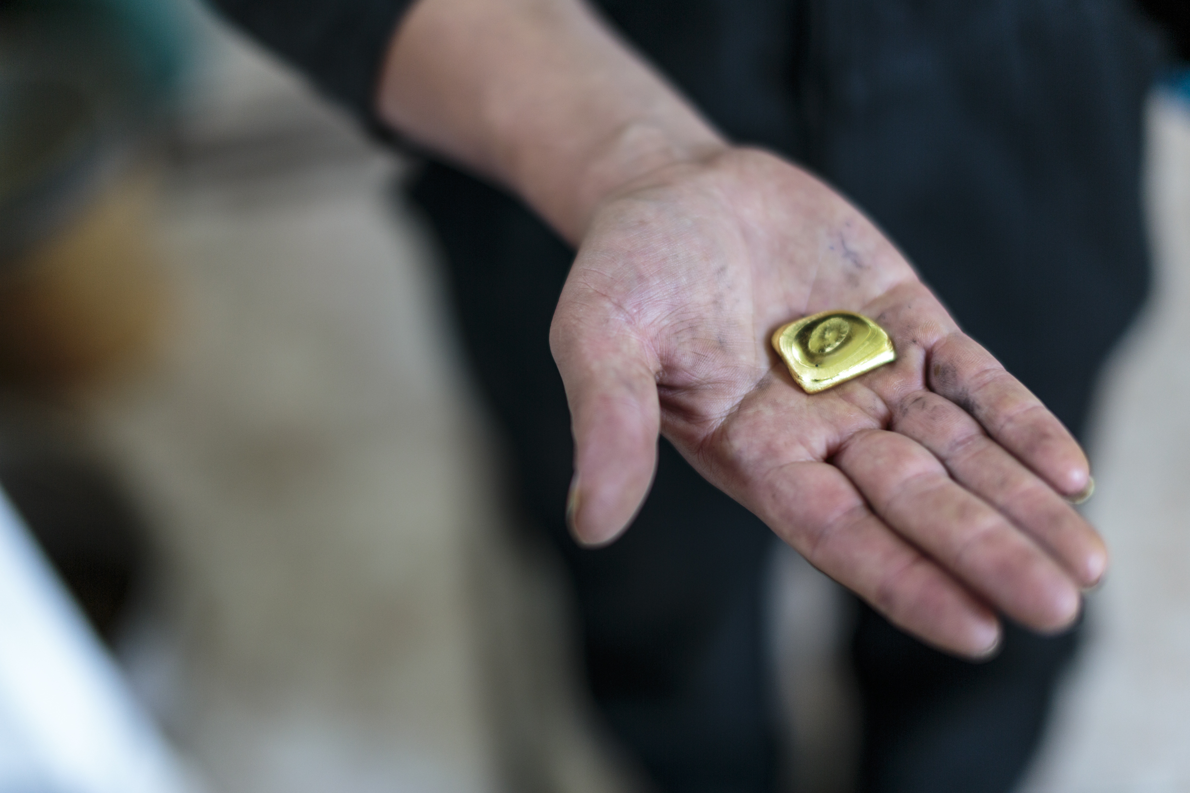
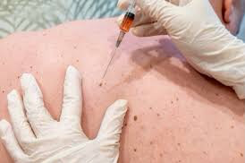
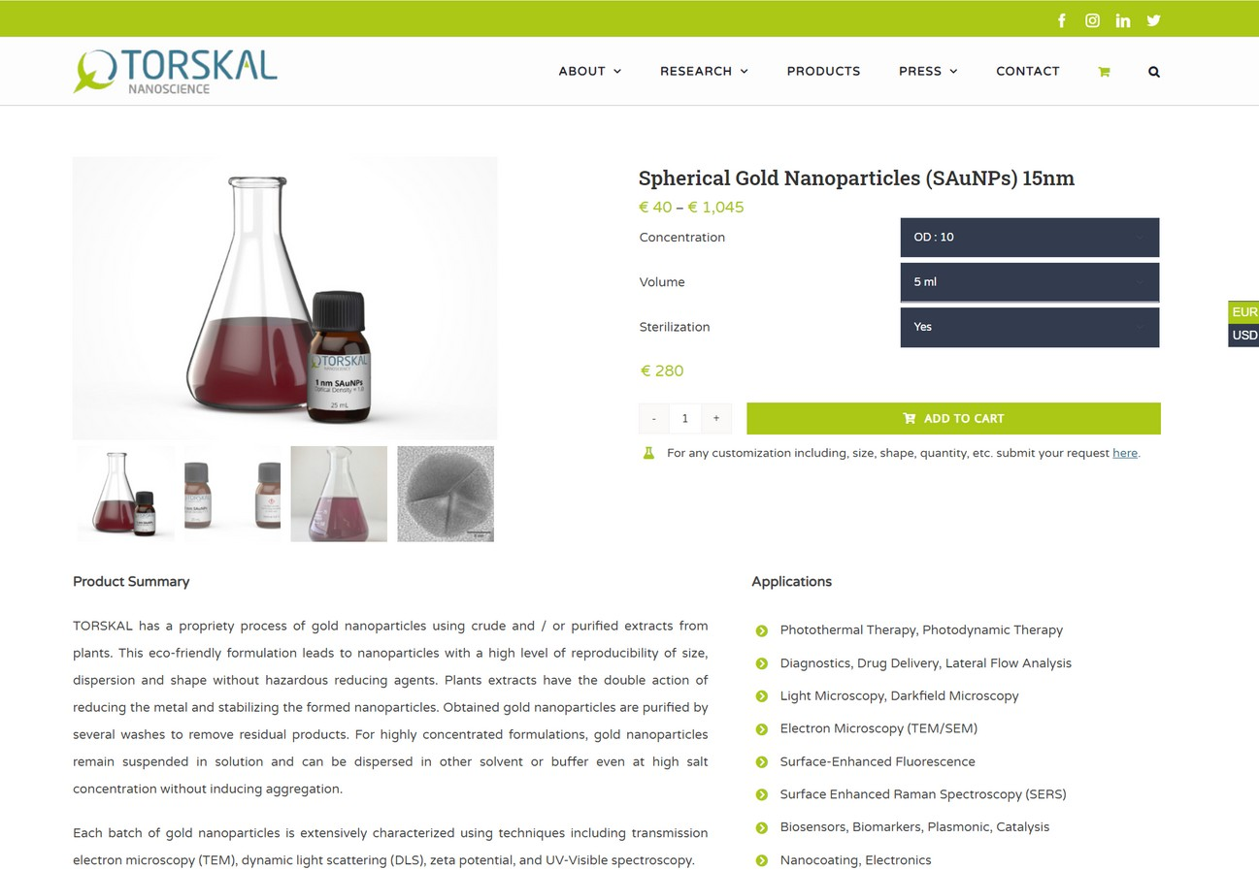
Cure the cancer with ethical gold

